Slide 1


Presented By: Joseph Attieh Clara Akiki
Optical Character Recognition

Slide 2
Objective and Tools
Learn how to construct an ANN based agent that recognizes handwritten letters
JAVA is the programming language used in our project
With the help of java (javafx) and css in order to create GUIs

Slide 3

Overview
Pre-process the image containing the letter
Retrieve different features
Build and train multiple ANN agents (developed in project 1) taking as input the different features extracted
Aggregate the output of the multiple agents built

Slide 4
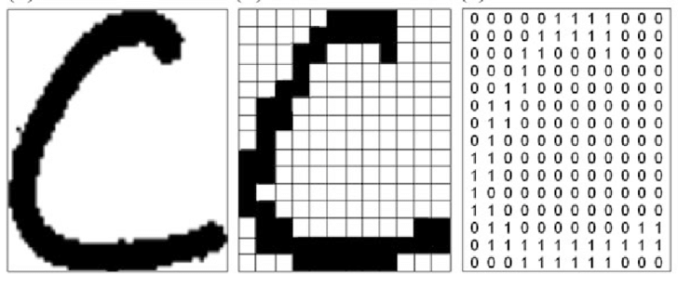
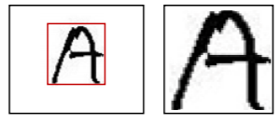
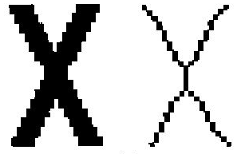

Image Pre-Processing
Minimum Bounded Rectangle (Crop)
Skeleton
Resize
Binarization

Slide 5
Feature Extraction
Diagonal Feature
Zoning Feature
Projection Histogram

Slide 6
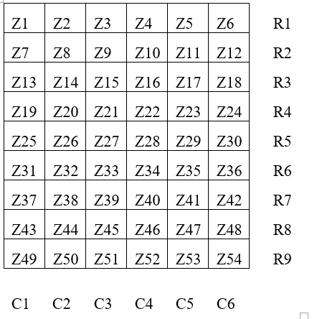
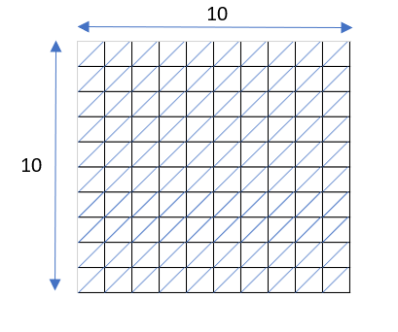
Feature Extraction
Diagonal Feature:
Input: preprocessed image of size 90*60.
Output: Feature vector of size 69
1-Resize the image to 90 x 60 pixels
2-Divide into 54 equal zones each of size 10 x 10 pixels
3-For each region
Get the average value of pixels among each diagonal out of the 19 diagonals
Average them out to get one single value
Attribute value to region
4-For each row
Get average values row wise
5-For each column
Get average values column wise

Slide 7
Feature Extraction
Zoning Feature:
Input: pre-processed image of size 32x32.
Output: Feature vector of size 98
1-Resize the image to 32 x 32 pixels
2-Divide into 64 equal zones each of size 4x4 pixels
3-Compute density for each zone:
Get the average value of on pixels(black) over all the pixels in that zone
4-Compute Up-Down, Right-Left density:
Calculate the total number of on pixels in the up, down, left and right regions
Diff1=(up-down)/total number of pixels
Diff2=(left-right)/total number of pixels
5-Compute the consecutive density:
Calculate the density of two consecutive zones
LEFT
RIGHT
UP
4
DOWN
4

Slide 8
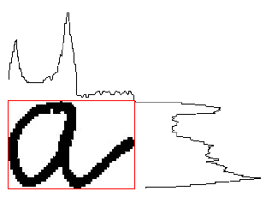
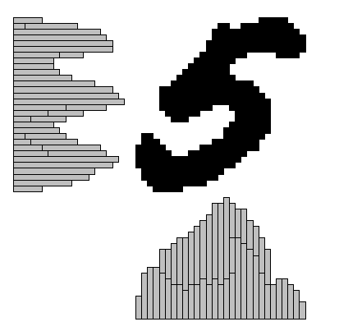
Feature Extraction
Projection Histogram:
Input: pre-processed image of size 32x32.
Output: Feature vector of size 127
1- Horizontal projection
For each row:
if pixel is black then countR++
2- Vertical projection
For each column:
if pixel is black then countC++
3- Diagonal projection
For each diagonal:
if pixel is black then countD++

Slide 9
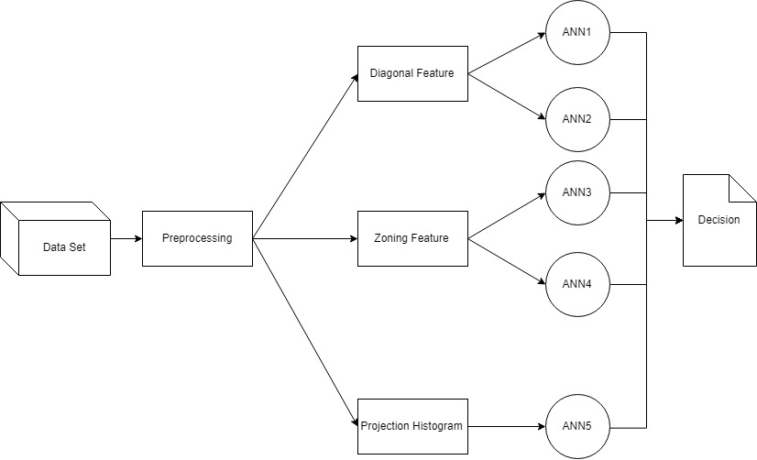
Overall Design
Weighted sum

Slide 10
DEMO

